Slide 1
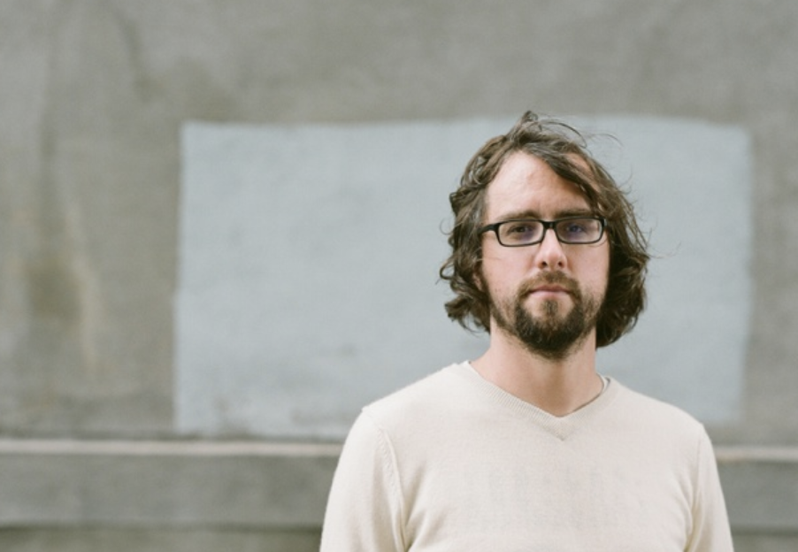
Jer Thorp
1975-
“I build tools for myself… for fun… they occupy the weird space somewhere between science, art, and design…. I’m building visual tools to help me understand systems.”
TedX talk 2012

Slide 2




Jer Thorp : Biography
Adjunct Faculty
Innovator-in-Residence
“Data Artist in Residence”

Slide 3
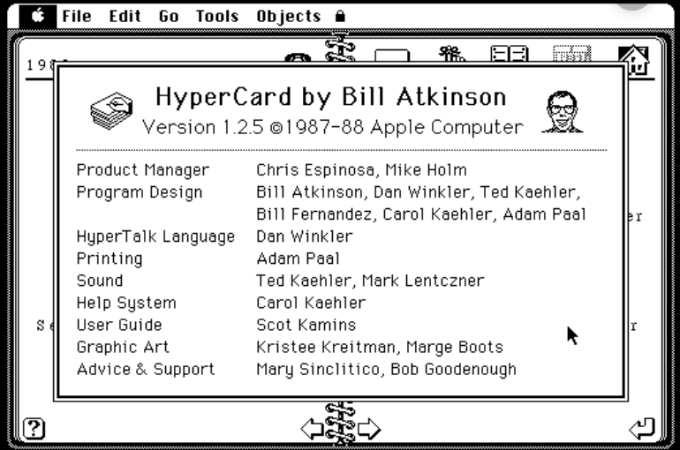
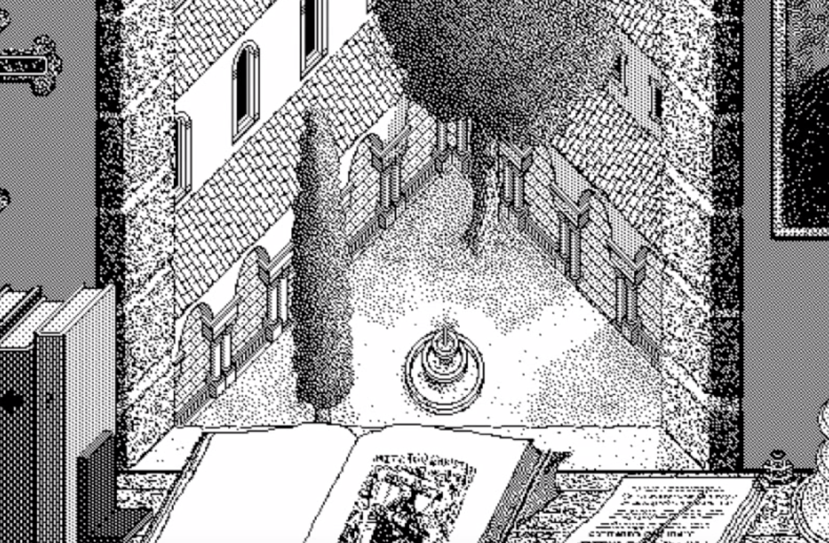
Inspiration
Hypercard, Apple Computer, 1987

Slide 4
Themes
Exploration through ”systems”
Ethics
Beauty
Surprise
Forms beyond glass screens

Slide 5
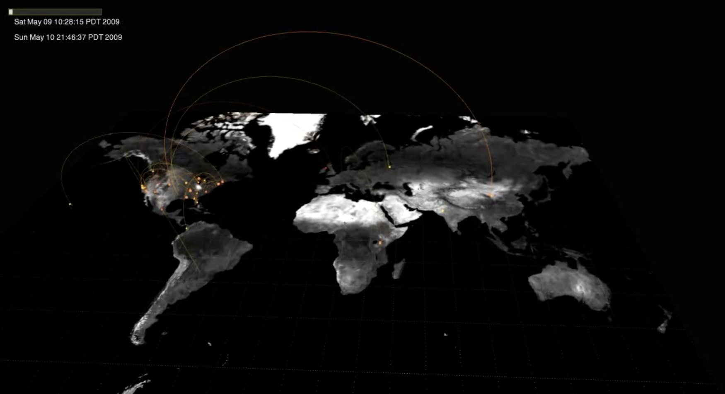
“Just Landed” 2009
https://vimeo.com/4587178

Slide 6
“Just Landed” Revisited, 2018
“While my intentions were good, I later learned that several advertisers saw the piece as a kind of instructional video for how personal data could be scraped, unbeknownst to users, from a Twitter feed. At no point in the development of Just Landed did I stop to consider the implications of the code I was writing, and how it might go on to be used. Unbeknownst to me, I was complicit in the acceleration of dangerous "big data" practices.”
Jer Thorp
February 2018

Slide 7
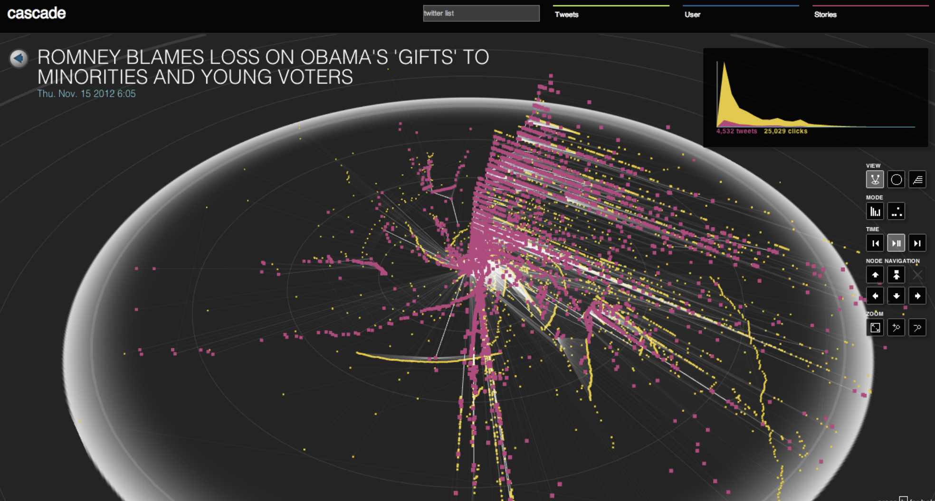
“Cascade” 2012
https://www.youtube.com/watch?v=Q9wcvFkWpsM
7:06

Slide 8
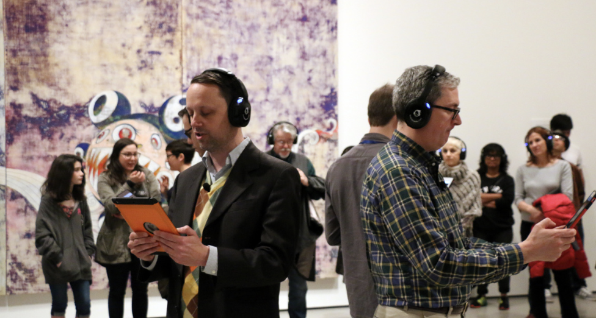
In OCR’s piece “Thousands of Exhausted Things,” the title, artist, medium and dimensions of every work in the collection has been contextualized through performance. The idea for one scene began in an email from Hansen, a world class statistician. His note contained only a list of names, the meaning of which Thorp and Rubin didn’t initially grasp. This list became a scene performed by a man and a woman: the man steadily reads the names in the sequence, all male, with many minutes passing before the female actor finally interjects desperately with a woman’s name. It is revealed that the duo is reading the first names of the artists in MoMA’s collection, sequenced by how frequently they are represented, teasing out the gender imbalance entrenched in the collection. This archive acts as a kind of cultural history, embodying what might be well-known to students of art history but is largely invisible to those walking the halls of the museum. From data, the OCR once again creates avenues to insight.
https://vimeo.com/133815147

Slide 9
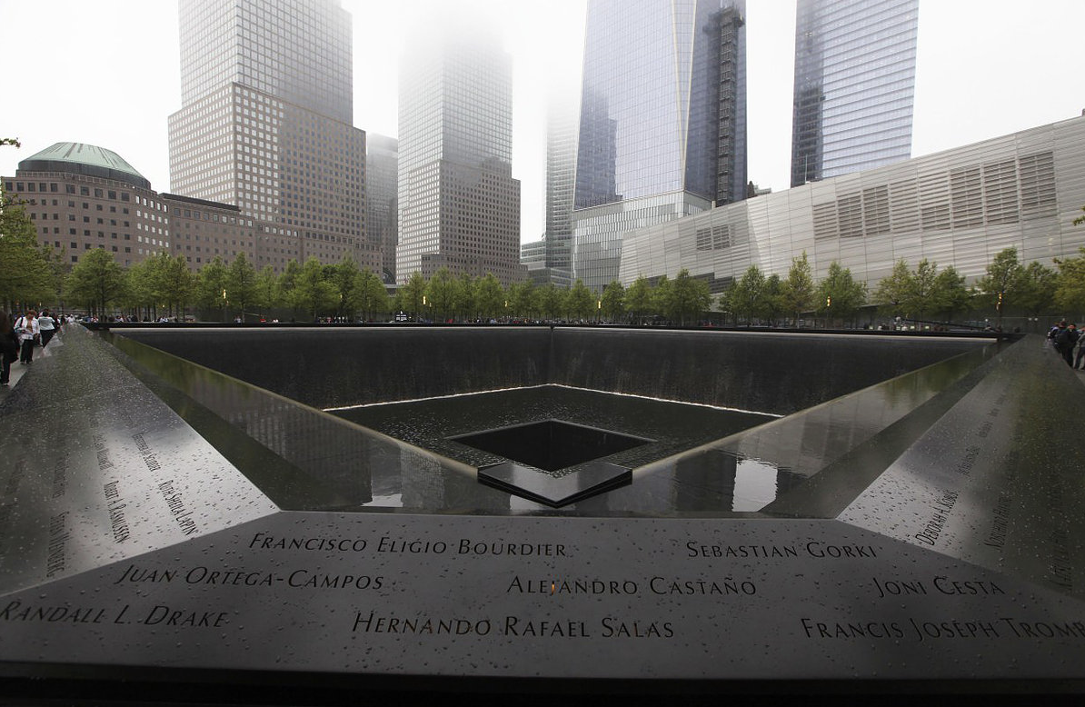
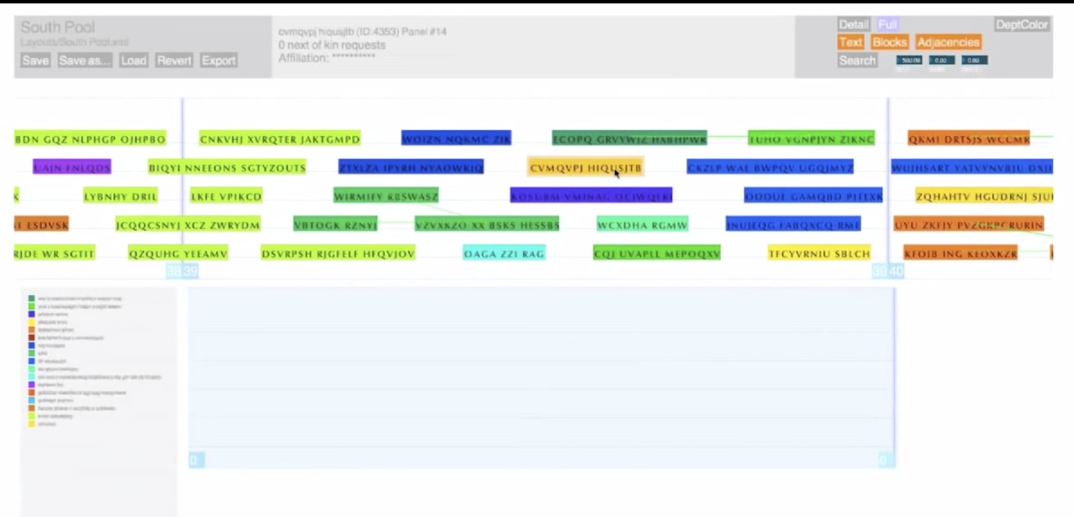
“9/11 Memorial : Name Placement”
2,500 names
1400 adjacency requests

Slide 10
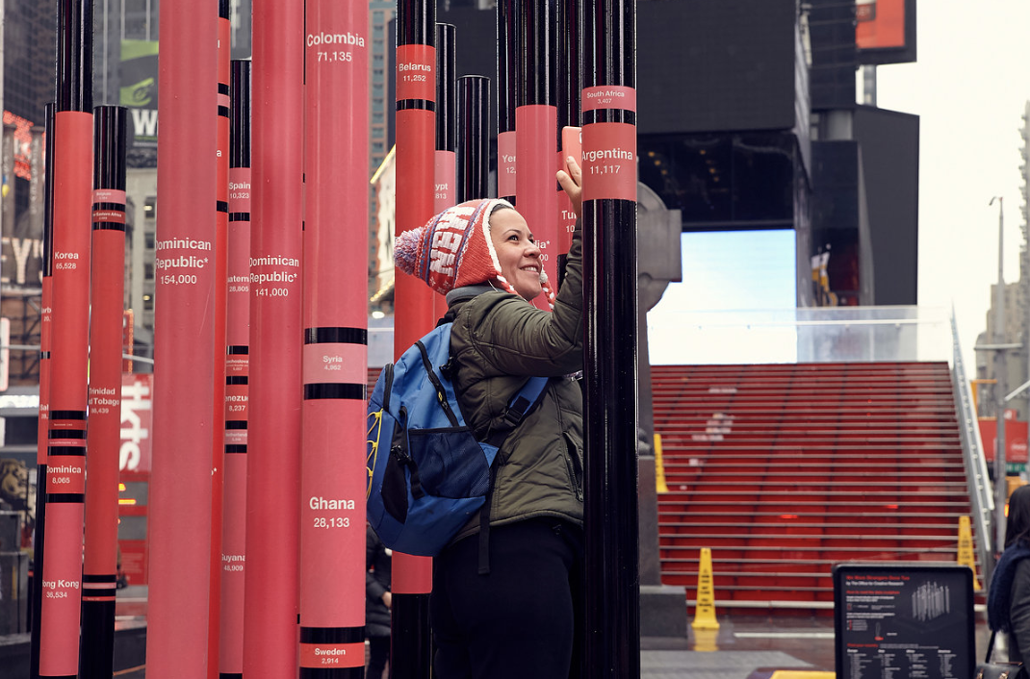
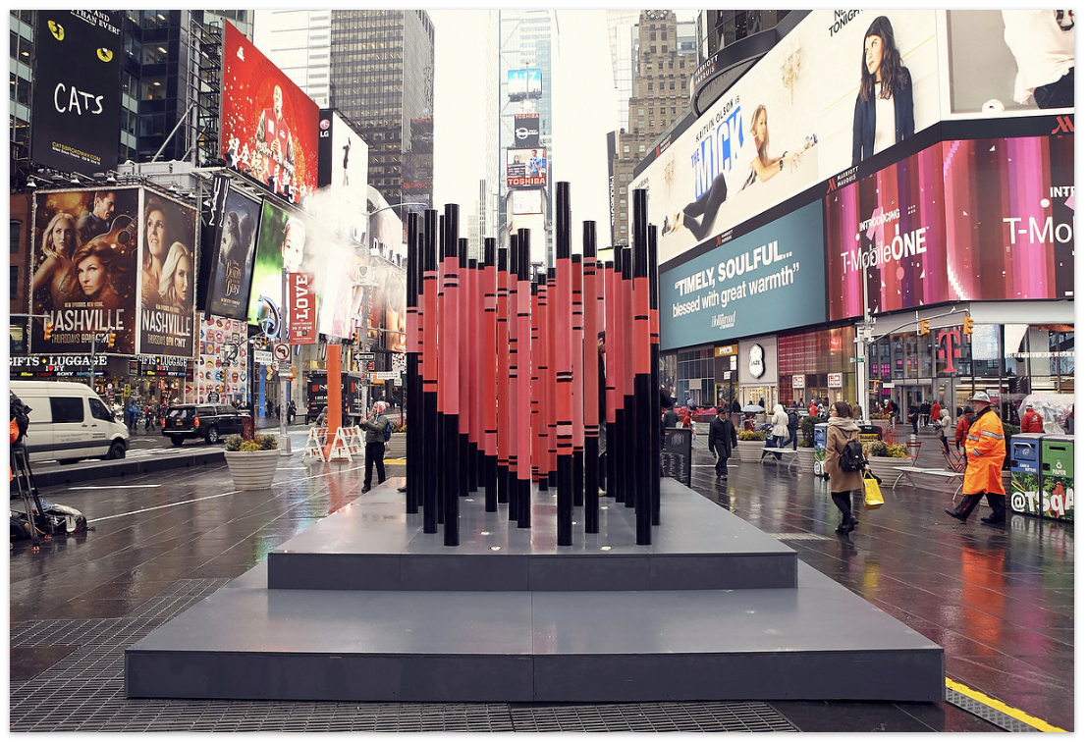
“We were once strangers too” 2017
Made of 33 metal poles each inscribed with the immigrant population in NYC coming from an individual nation, a viewer’s shift in perspective resolved the sculpture to an iconic heart when viewed from the statue of Father Duffy in the center of Times Square.
https://www.youtube.com/watch?v=72CO1m7tBhs

Slide 11
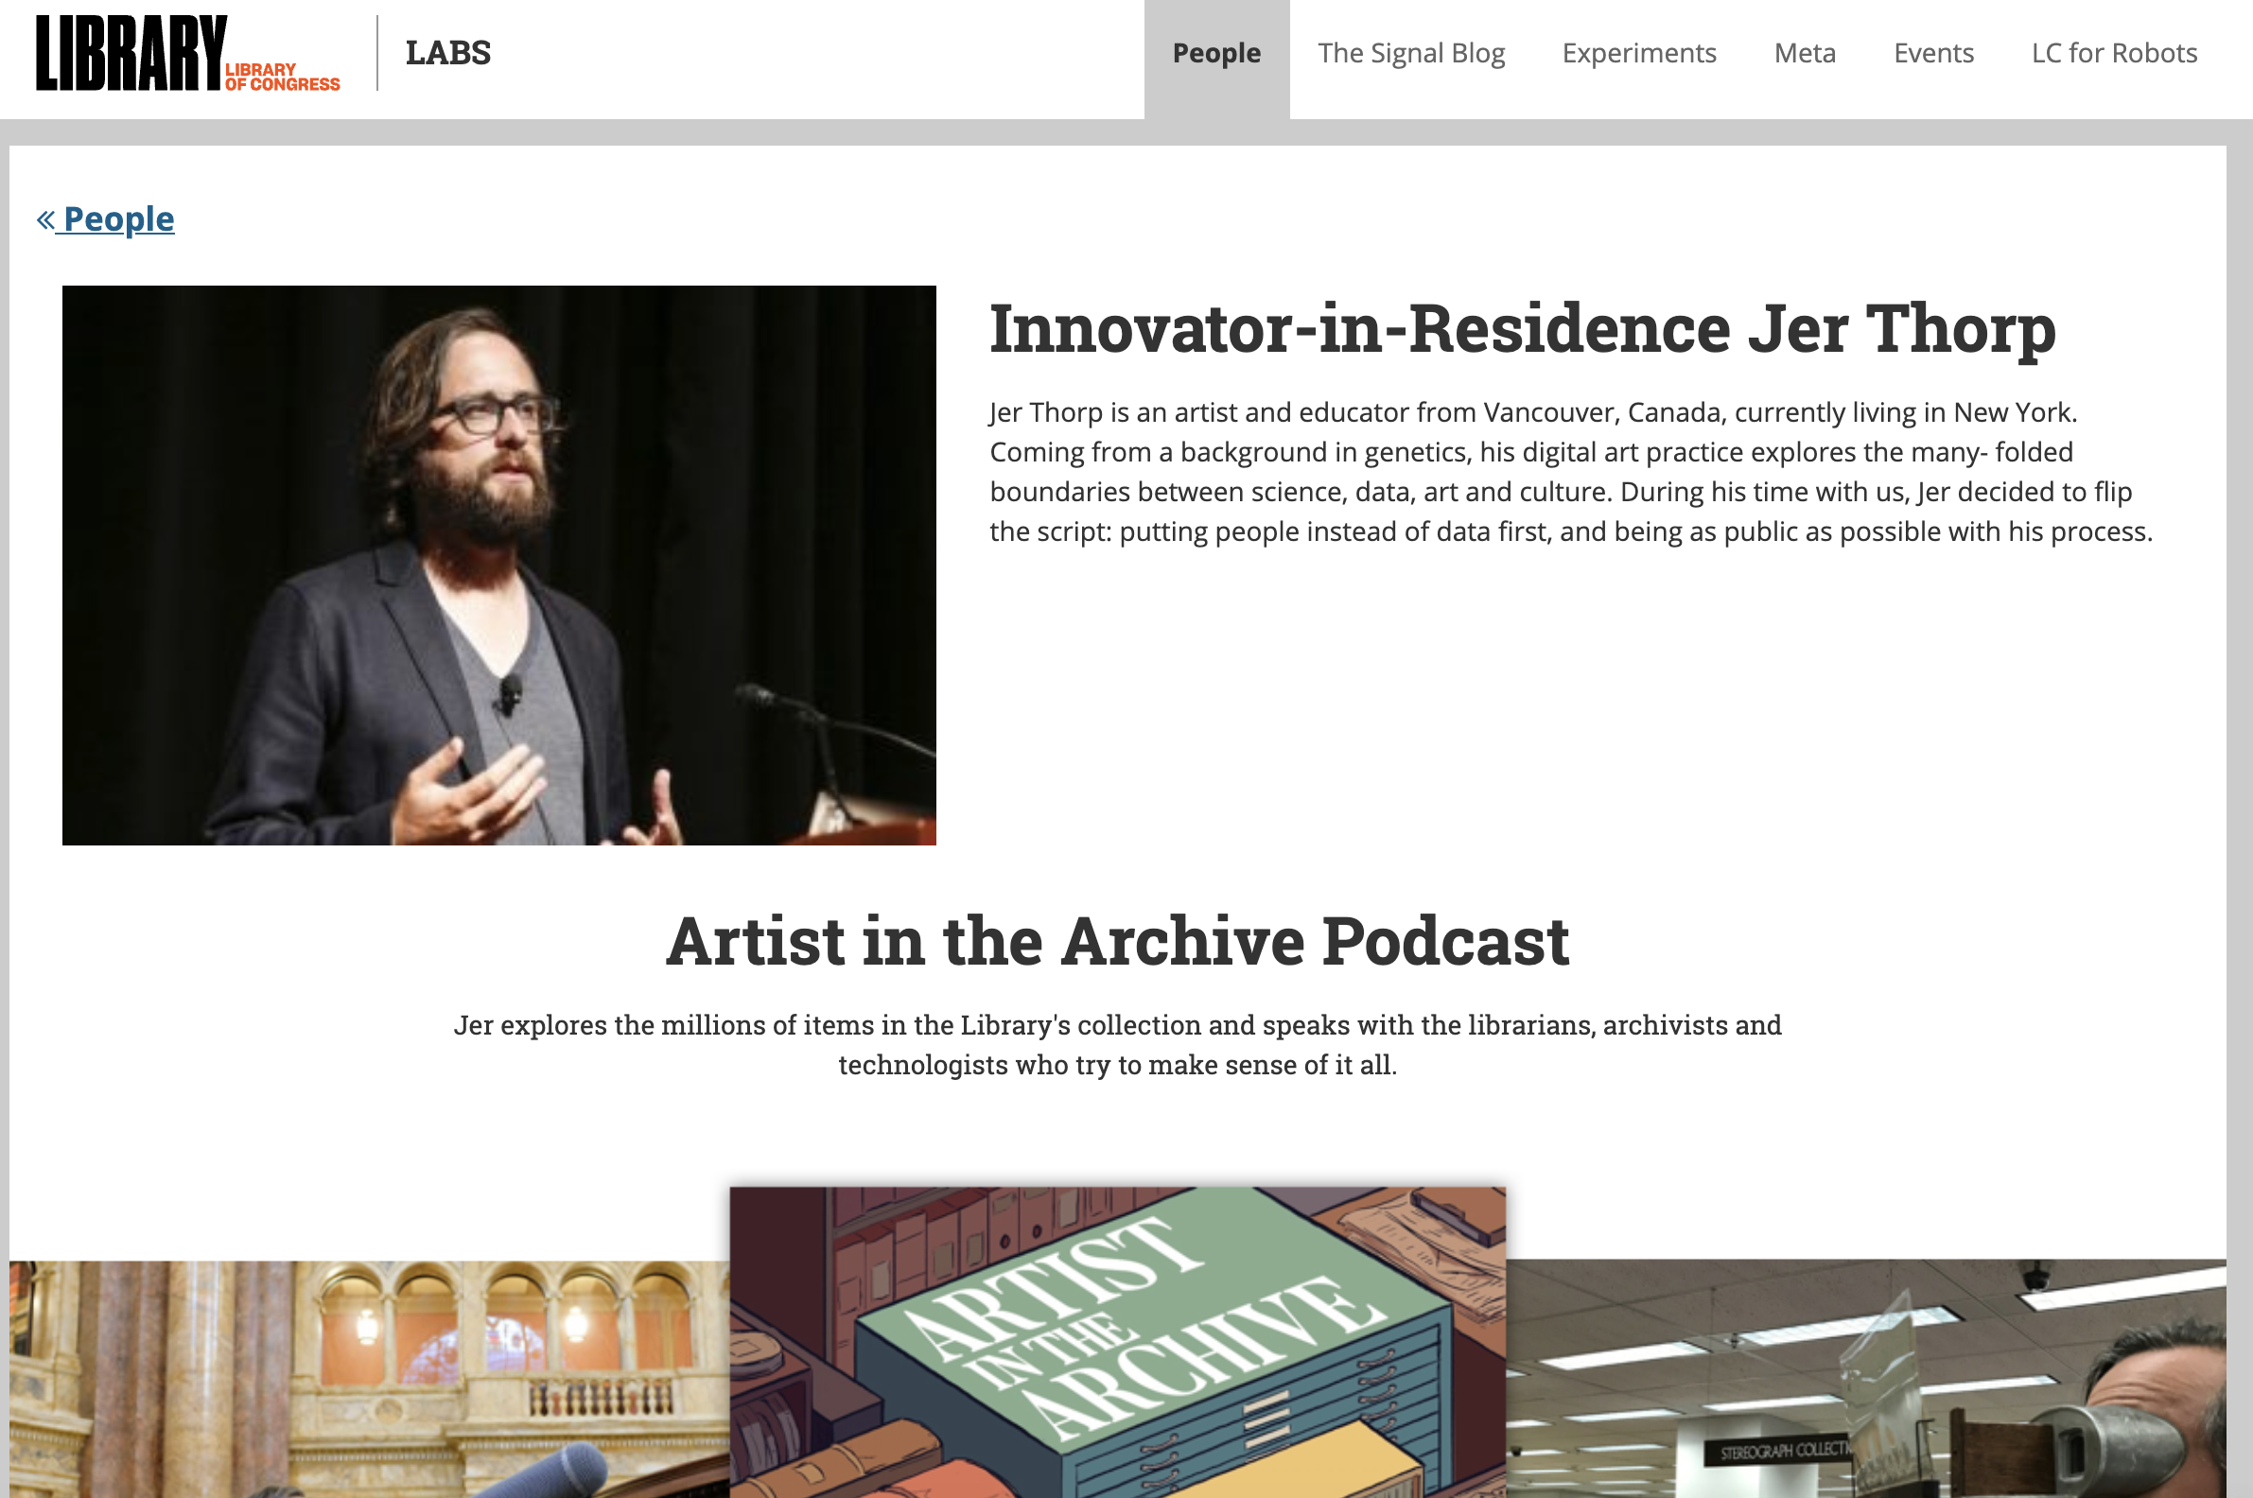

Slide 12
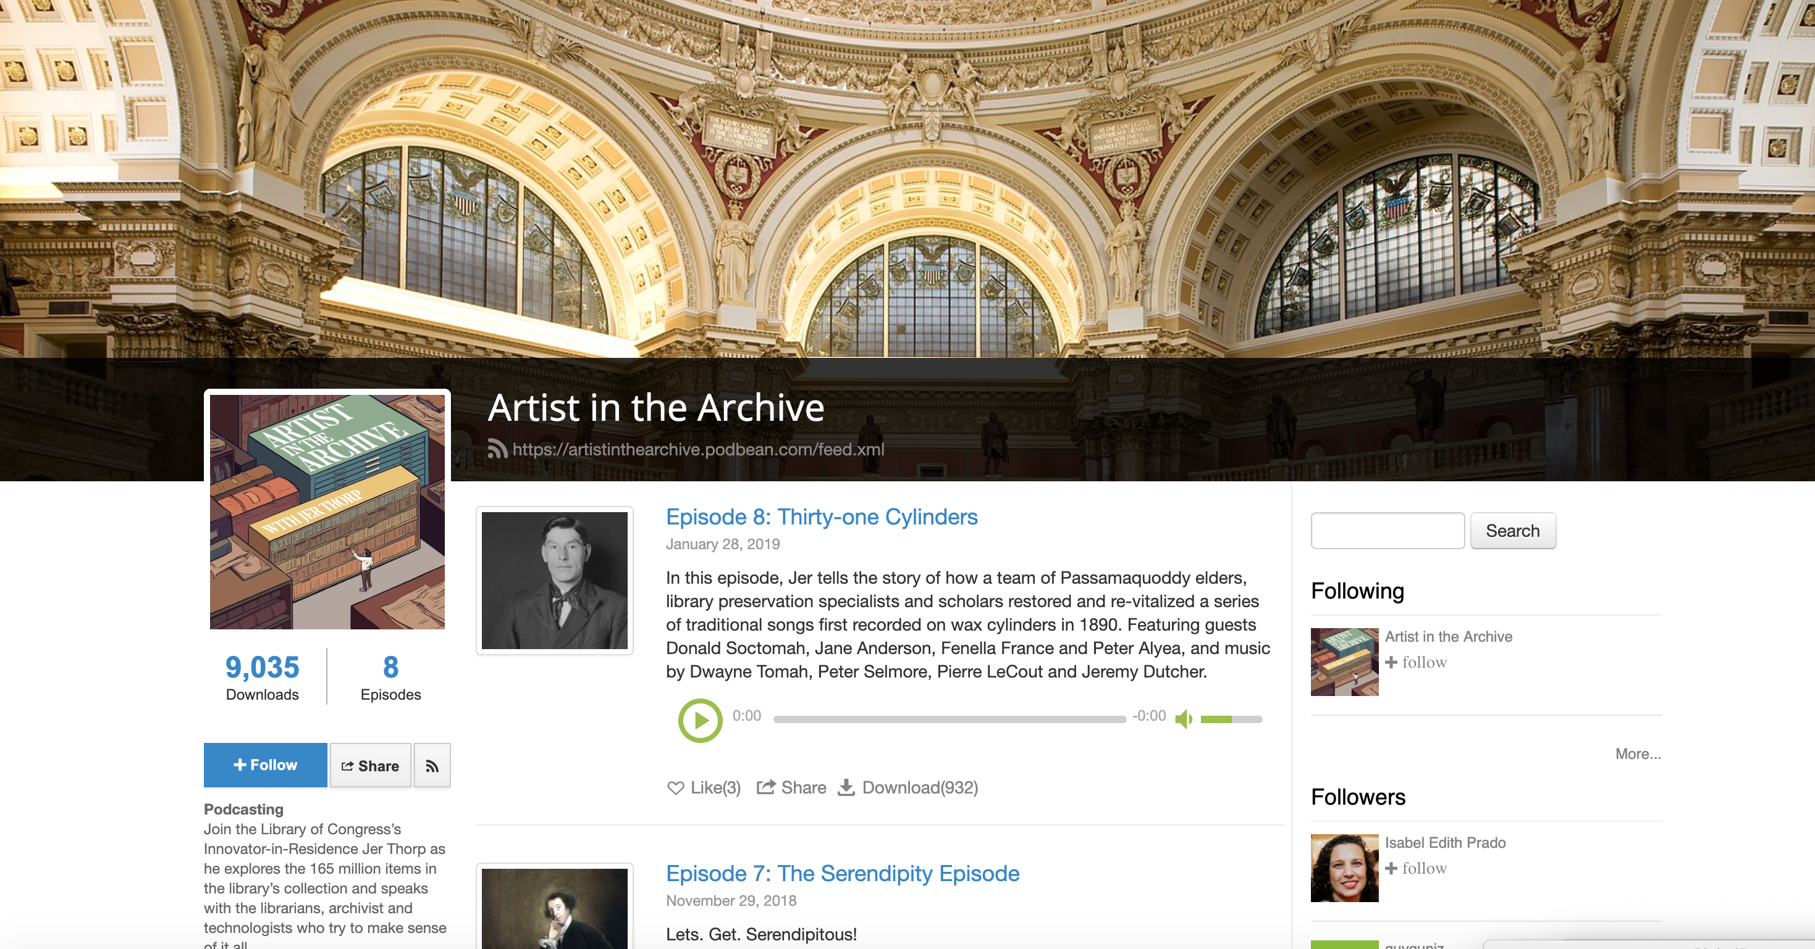

Slide 13
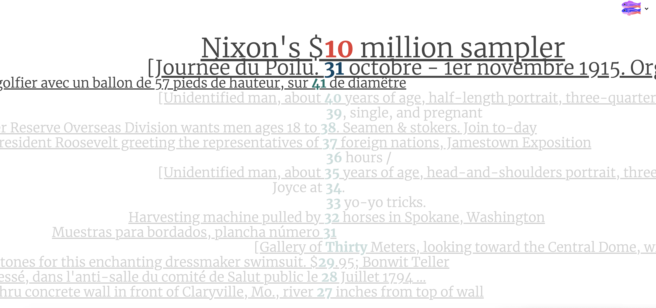
“Library of Time” 2017-18

Slide 14
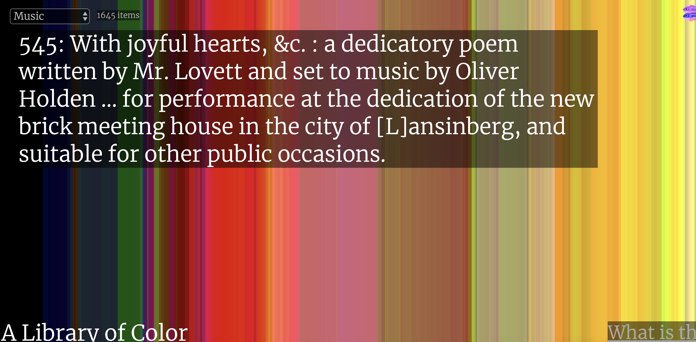
“Library of Colors” 2017-18
https://library-of-colors.glitch.me/

Slide 15
For more
Jerthorp.com
Vimeo not Youtube
Podcasts & examples at Library of Congress

